Slide 1
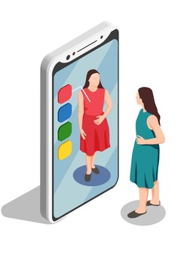
Smart Fitting Room
Group Members: Mohamed Ayman, Mohamed Osama, Mohamed Abdelaziz,
Tarek Medhat
Supervised By: Prof.Khaled Hussien, Eng. Hager sobeah, Eng. Maha Sayed

Slide 2
AGENDA 1/2
01
02
03
04
Introduction
Problem Definitions
System Objectives
System Overview
05
06
07
08
Context Diagram
Sequence Diagram
System Architecture
Scenarios

Slide 3
AGENDA 2/2
09
10
11
12
Algorithms & Libraries
Dataset Description
Results
Demo

Slide 4

Introduction
The System targets vendors and clients that would use the online fitting room application:
Online Fitting Room mainly helps client to fit chosen items virtually and choosing suitable size
Help brand owner to decrease returning percentage by making clients fit clothes virtually on them.

Slide 5
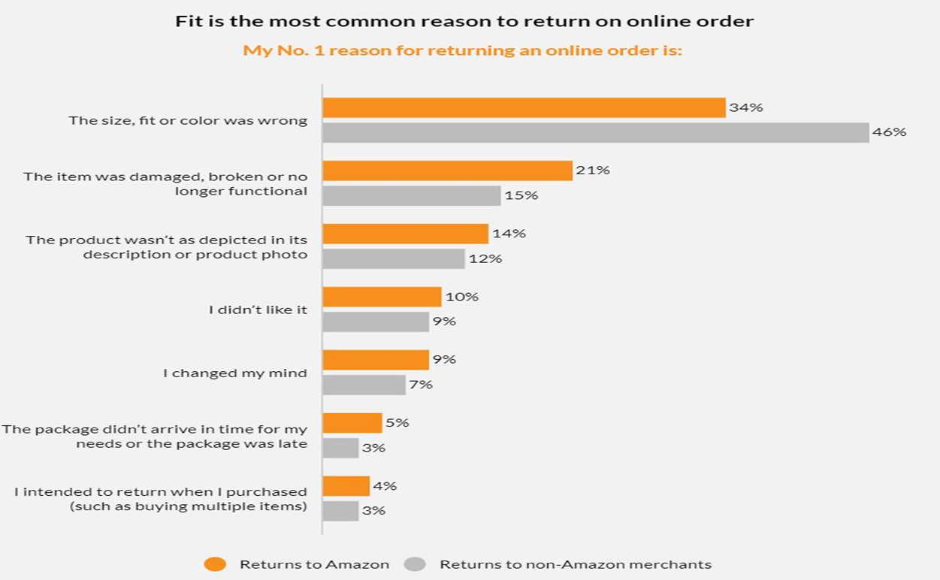
Problem Definitions

Slide 6


System Objectives
Items
Accuracy
Sales

Slide 7
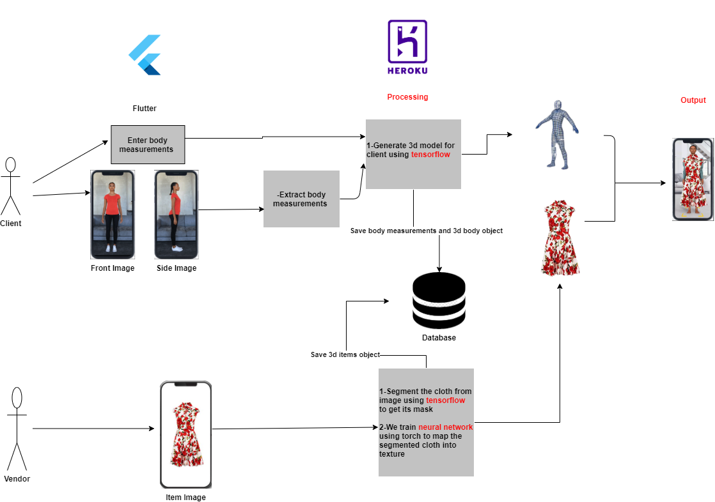
System Overview

Slide 8
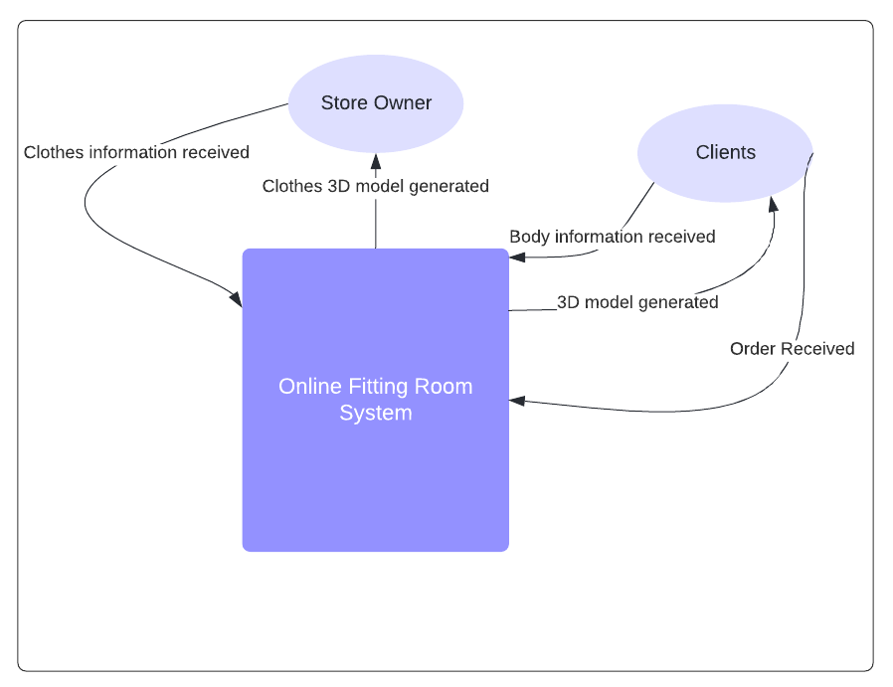
Context Diagram
Store Owner
Put items of his brand in the system
Clients
Has to provide the system with his body measurements
Can try 3D item model on his 3D body model
Can make order for his fitting clothes

Slide 9
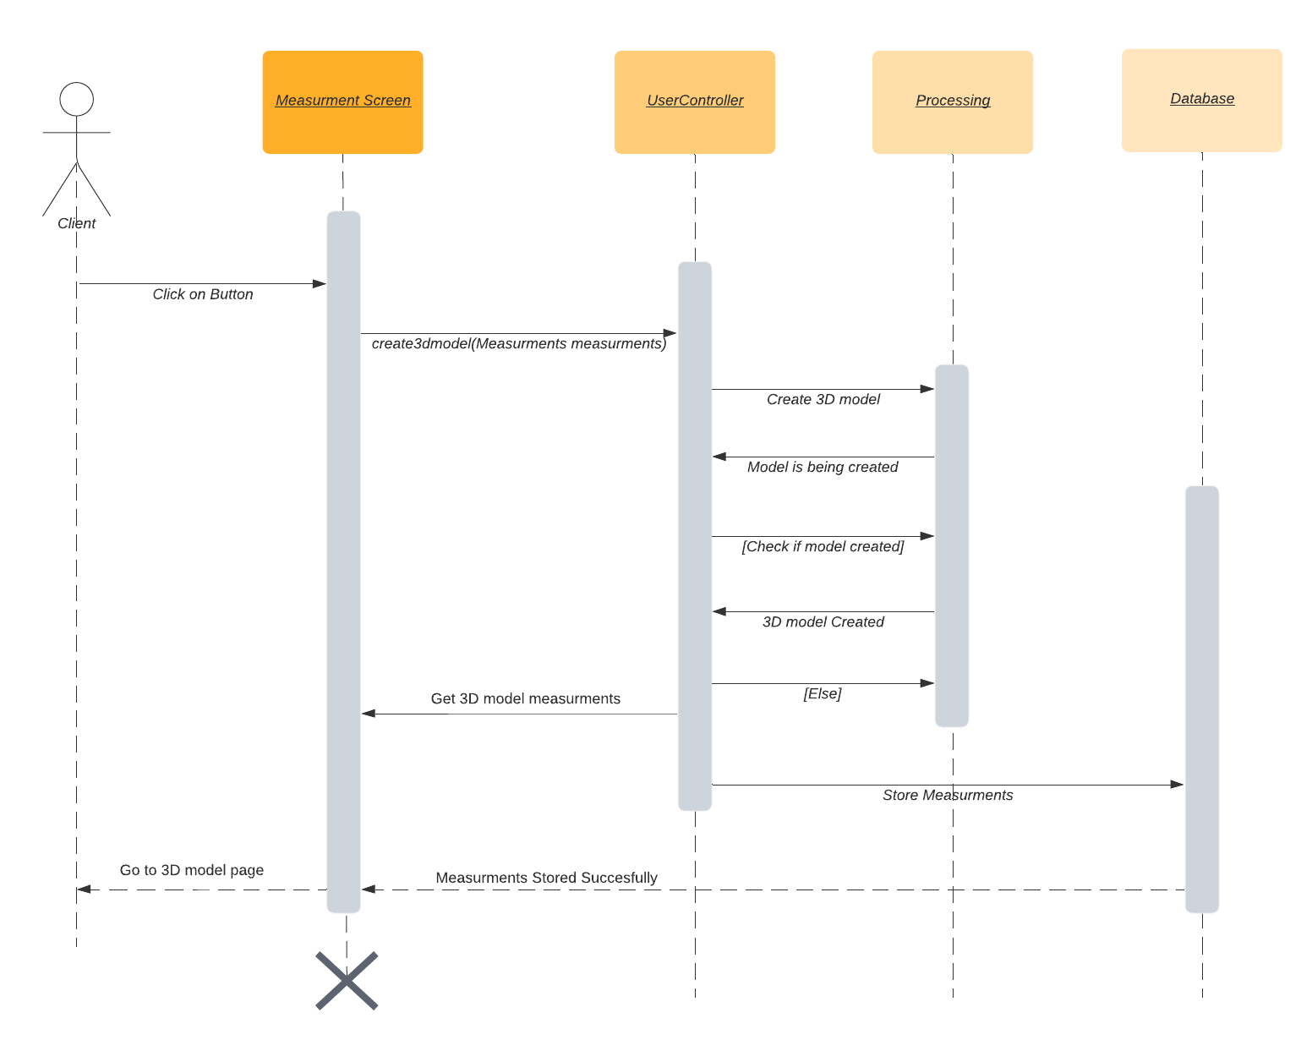
Sequence Diagram

Slide 10
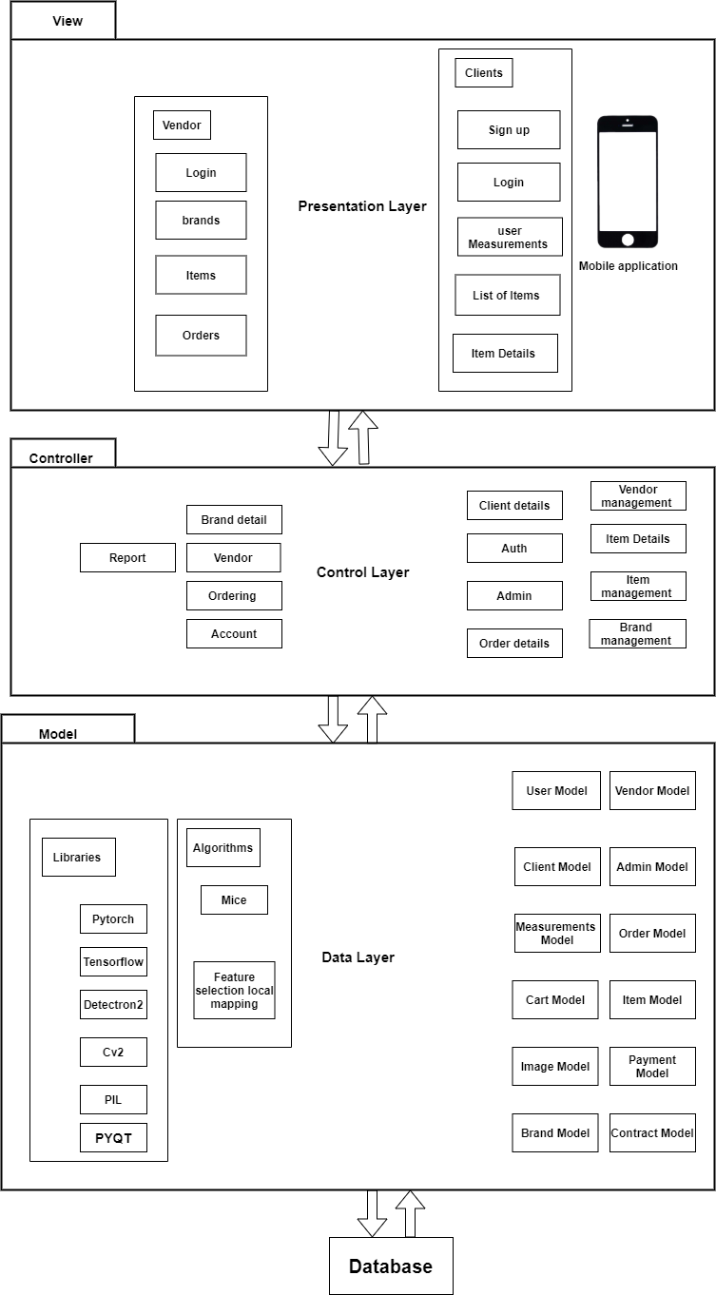
System Architecture

Slide 11

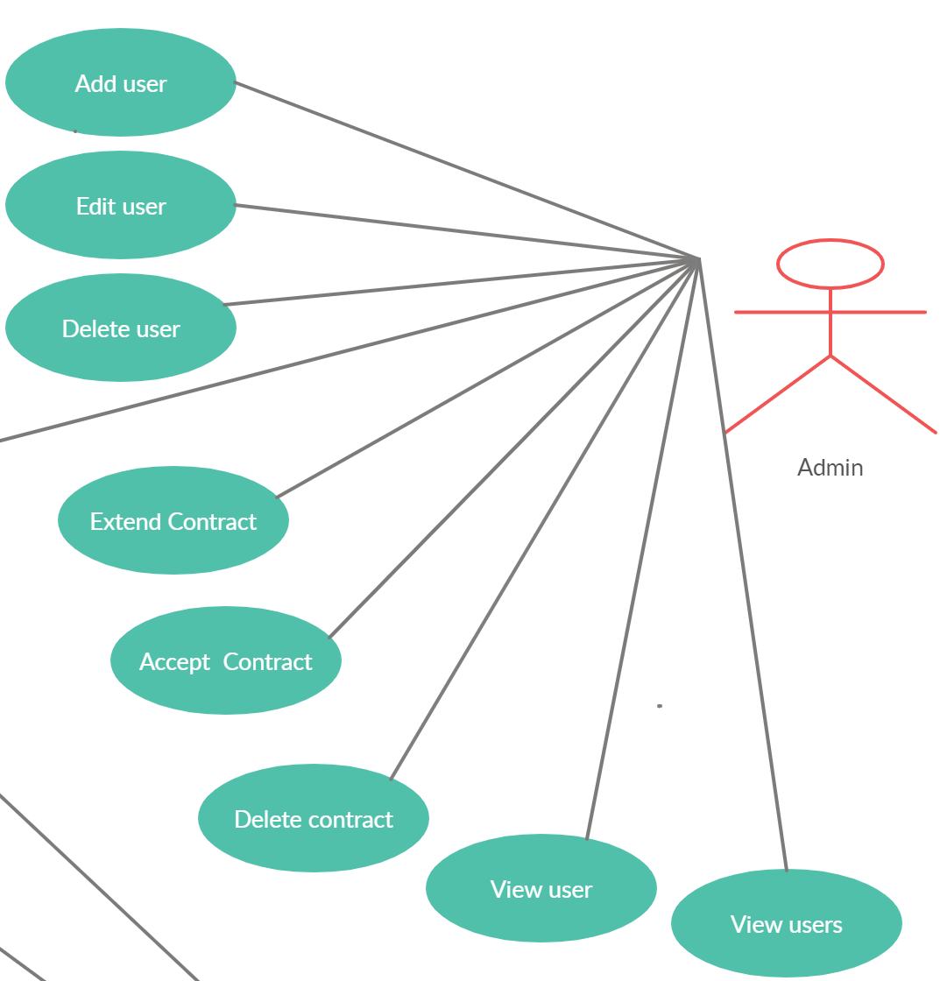
Admin Scenario
Can see users that access to the system
Can access vendor to the system after sign the contract
Have authority to add, edit and delete any inactive user

Slide 12
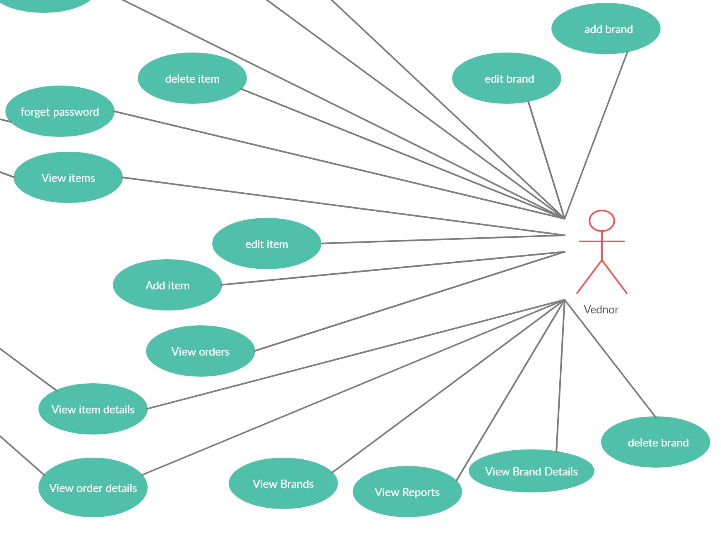
Vendor Scenario
Can add his brand on the system
Can view all orders details.
Have authority to add, edit and delete in his brand’s details.
Can see monthly report contain all sales operation

Slide 13
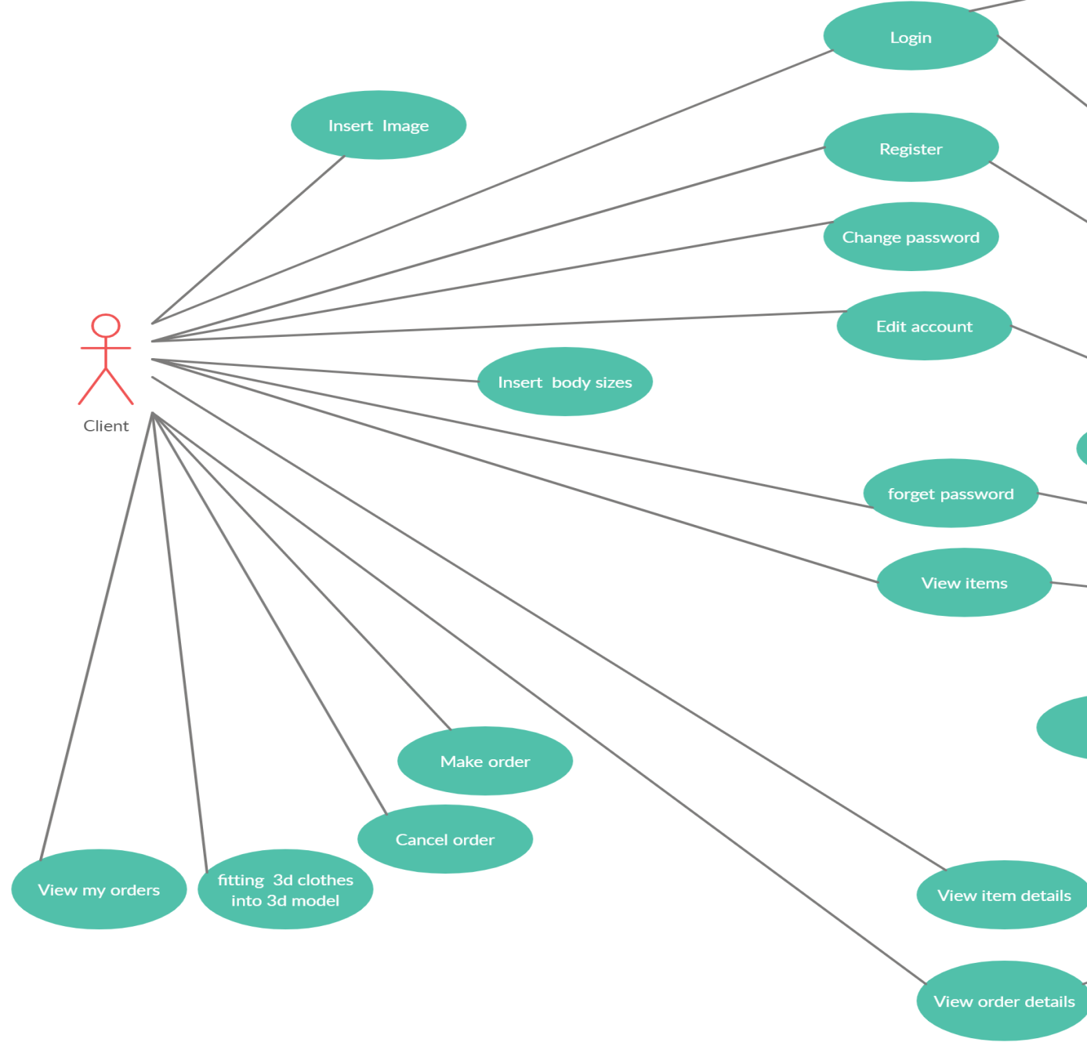
Client Scenario
Have choice to add his body measurements or upload two images of his body to create 3D model.
Can view his order details and item details
Have authority to edit his account
Can see 3D clothes on his 3D body model

Slide 14
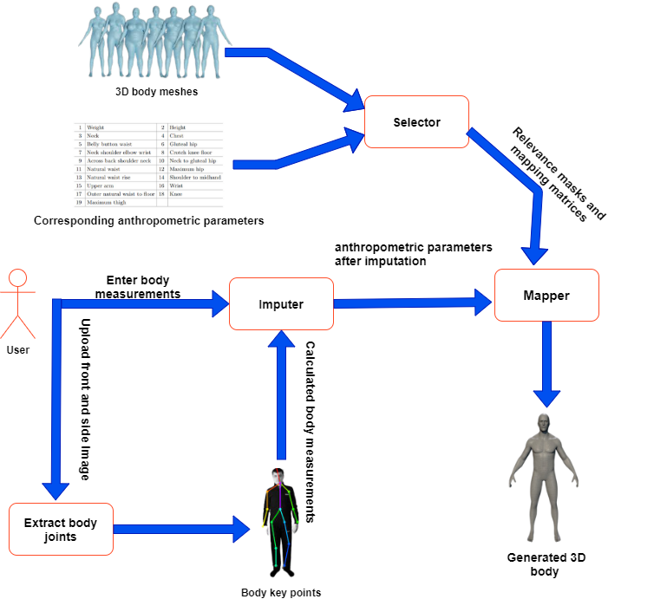
Algorithms1/2
Generated 3D model for human body

Slide 15
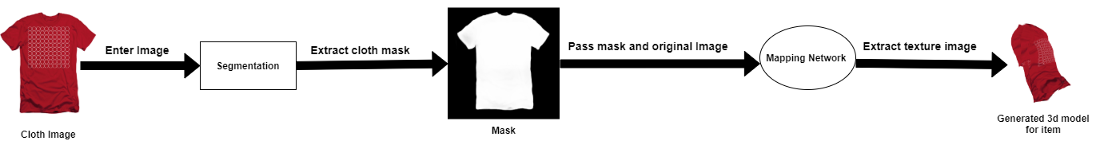
Algorithms2/2
Generated 3D model for item

Slide 16




Libraries
Detectron2
CV2
TensorFlow
Pytorch

Slide 17
Dataset Description
SPRING | Dataset Name
Dataset of 2GB which contains 3D scan meshes of 1517 male and1531 female. Each mesh has 12500 vertices and 25000 facets | Size
3000 subjects | Number of Subjects
The data is derived from the CAESAR dataset | Notes

Slide 18
Results
Global Mapping | Local Mapping
8.45 | 3.17 | Neck
28.13 | 10.33 | Chest
23.78 | 10.67 | Belly button waist
20.63 | 9.5 | Gluteal hip
11.41 | 7.26 | Neck shoulder elbow wrist
15.39 | 10.38 | Crotch knee floor
11.52 | 4.69 | Across back shoulder neck
15.1 | 9.74 | Neck to gluteal hip
22.97 | 10.61 | Natural waist
21.71 | 10.3 | Maximum hip
28.62 | 16.71 | Natural waist rise
8.29 | 3.83 | Shoulder to midhand
10.47 | 4.82 | Upper arm
4.54 | 2.35 | Wrist
14.35 | 9.11 | Outer natural waist to floor
9.92 | 4.67 | Knee
18.49 | 14.65 | Maximum thigh

Slide 19
Demo

Slide 20
Thanks !

